Slide 1

Facebook Birthday Wisher
By:
ABHISHEK AGGARWAL(110011)
SAURABH JADHAV(110564)
SHIVANI GARG(110137)
UNDER THE GUIDANCE OF
Prof. Awadesh Kumar Singh

Slide 2

Introduction
We are using Facebook’s graph API and Java API namely Facebook4J, to make an application that allow users to wish their friends with a personalized video that would be generated depending both the sender and receiver's facebook profile activities as well as some other relevant factors.

Slide 3
Why create a Facebook app?
Primary Account Creation and Login = Real Identities Facebook users are already profiled. (No need for more info forms.)
Distribution:You have a global audience that you can tap on –2.767 M as of Oct 2008
Automatic Social Graph Users can find their Facebook friends on the site.
Facebook Connect’s ability to Publish content to the Facebook News Feed in a social and therefore highly relevant way

Slide 4
Implementation
Our application will have the following features:
Access the user’s information via fb login
Subscribe to filtered birthday notifications
Send an automated video greeting or schedule it.
Make that video personalized by adding custom texts and music.

Slide 5
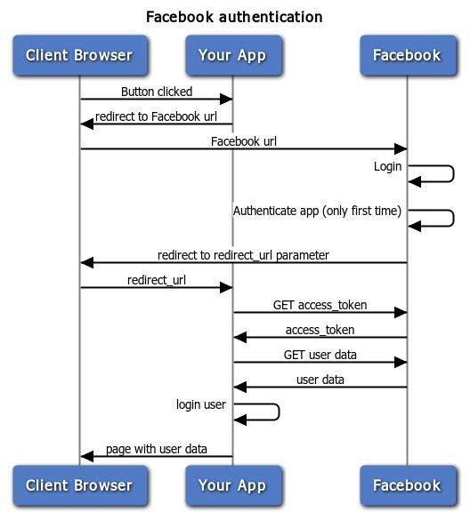
fig. how facebook authentication works

Slide 6
Software and Language specific requirements:

Slide 7
Deliverables from the project

Slide 8
Possibility of extension
We hope to learn more about the contemporary development platforms with multiple formats of input being reduced to an altogether different format. We have learned how to develop the software keeping in mind the preferences as well as the activities of user on the virtual social networking sites.
This application can be easily modified and extended to serve other purposes like posting educational videos according to the user’s recent activities as well as posting customized news according to his interests.

